Slide 1

IBM SkillsBuild for Adult Learners – Artificial Intelligence
Artificial Intelligence Internship Program 2024 Final Project Presentation
Project Name :Healthy-Kickoff
Unique ID :IBM5579 Team Name :Btech26(cse-it)
College Name :Cochin University College of Engineering,Kuttanad

Slide 2
Team Members
Muhammed Shahzad
Sreenand S
Mohammed Irfan
Midhun M Nair

Slide 3
Introduction
Overview of the Project
The program integrates football with health education and community engagement to improve well-being, educational outcomes, and social inclusion while supporting key SDGs.
Objective
To explore how soccer can be used as a tool to improve health outcome and support the achievement of various sdgs , including health education, gender equality and community development.

Slide 4
Problem Identification
Problem Statement
Limited Physical Activity: Many communities experience high levels of sedentary lifestyles, leading to increased health issues such as obesity, cardiovascular diseases, and mental health disorders.Educational Gaps: There is a need for innovative methods to enhance engagement in education and develop critical life skills among students.
Significance of the Problem
1. Health Impact: Sedentary lifestyles lead to health issues like obesity and mental health problems. Football can combat these issues by promoting physical activity and mental well-being.2. Educational Engagement: Football can enhance student engagement and learning outcomes, providing alternative pathways to reduce dropout rates.
Relevant SDGs
1.SDG3 (Good health and well being )
2.SDG 4( Quality education)
3.SDG 5(Gender equality)

Slide 5
Chatbot Design and Development
Conceptualization of Chatbot
A chatbot welcome the user with any predefined question the user can adivised upon
the user can further ask his/her relevant doubts to our chatbot for any further discussion.
Design Principles
User centric,Focus on purpose and goals,Inclusive design,Defined objectives
Development Tools and Frameworks Used
Wix studio And Wattson Ai

Slide 6
Chatbot Persona and Use Case
Chatbot persona
User-friendly, tailored response, simply languages and understandable and managed by age of any
Use case
To develo a structurd football program incorperating health,education and life skill training.
Link to the chatbot
http://surl.li/piqmpl
Link to the website
https://drive.google.com/drive/folders/1Mq6NBJE0V3W1tBQ8xhsoR4qg97favuJg

Slide 7
Dataset Used
Mention the datasets used for training the chatbot
This chatbot exclusively use wattsonX Assistant and use its corresponding datasets

Slide 8
Actions Integration
Input actions
User can type his/her question below on the type box or select any of predefined questions from chatgpt if their doubt is relevant to it.

Slide 9
Solution Design
Proposed Solution
To implement a soccer based program that integrate health education,physical activity and life skill training to enhance community well being educational outcomes and social inclusion.
Implementation Plan
Launch a soccer based program integrating health education and physical activity with ongoing support monitoring and scaling for long term impact.
Alignment with SDGs
Aligns sdg with promoting health (SDG3),education(SDG4),gender equality(SDG5) and community development(SDG11).

Slide 10
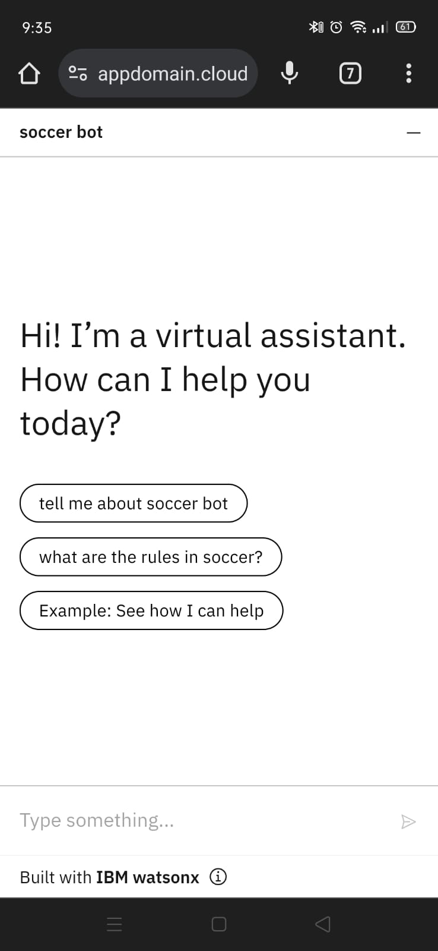
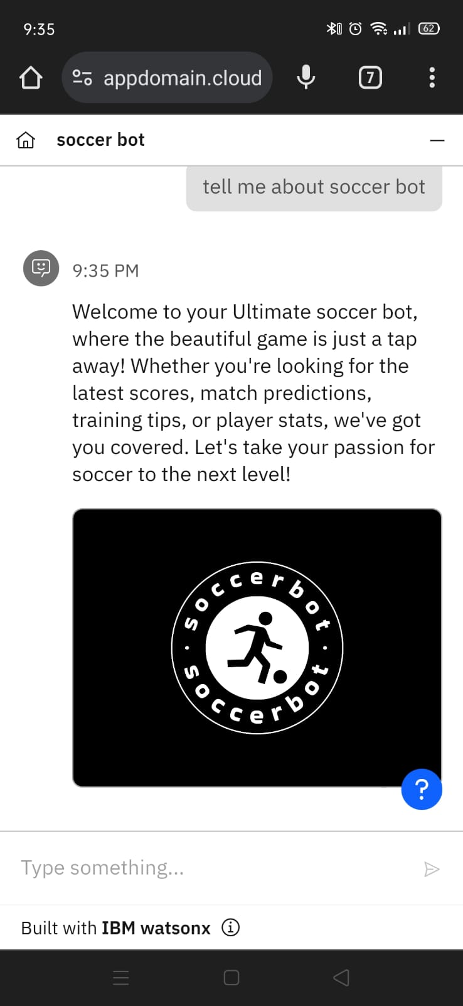
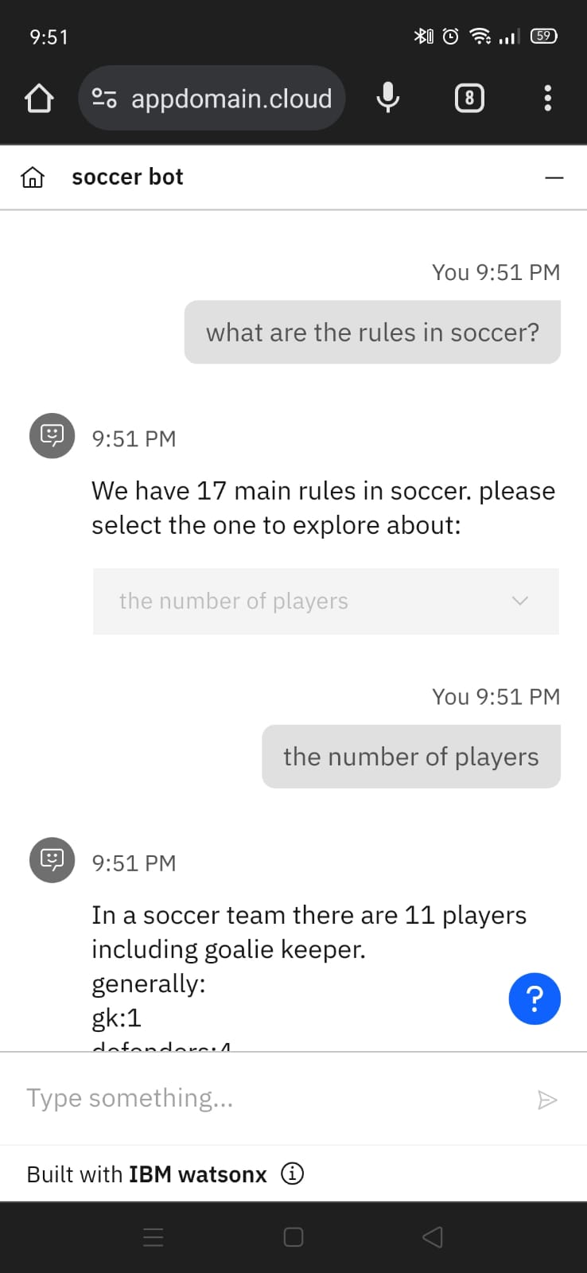
Screenshots
Input Screenshots of t your Chatbot

Slide 11
Conclusion
The program uses football to enhance physical and mental health, improve educational outcomes, promote gender equality, and strengthen community bonds, effectively contributing to multiple SDGs.

Slide 12
References
Data Sources
Chatgpt And Various AI focused websites
Tools and Software Used
Wix studio, Wattson X Assistant, Microsoft Word, Microsoft Powerpoint
Additional References
Wikipedia.

